Slide 1
WELCOME…

Slide 2
Mohammad Maruful Islam
19-40135-1
COMPUTER SCIENCE AND ENGINEERING

Slide 3
LINUX VS WINDOWS OPERATING SYSTEM

Slide 4
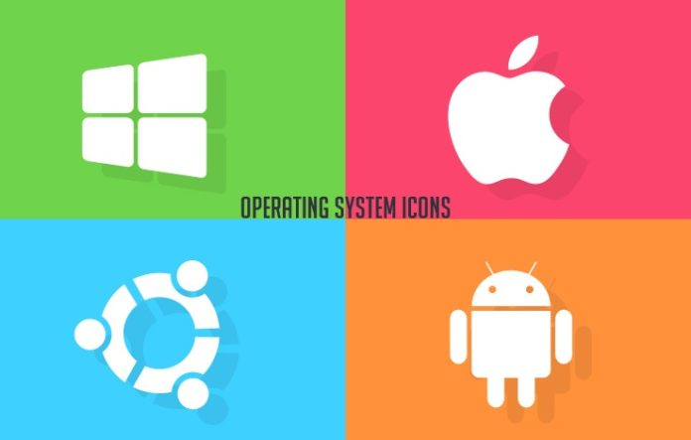
OPERATING SYSTEM
What is operating system?
Why it is used?
Example of OS

Slide 5

LINUX OPERATING SYSTEM
What is LINUX operating system?
When it came to the users?
Characteristics of LINUX
Why should users use LINUX operating system?

Slide 6

WINDOWS OPERATING SYSTEM
What is WINDOWS operating system?
It’s launched time
Characteristics of WINDOWS
Windows operating system to the common users

Slide 7
DIFFERENCES BETWEEN LINUX & WINDOWS…
Price
Ease of use
Reliability
Software and its cost
Hardware
Security
Support & used cases

Slide 8
Summary…
Decision…

Slide 9
Reference…
https://opensource.com/resources/linux
https://en.wikipedia.org/wiki/Operating_system

Slide 10
THANK YOU…

